Slide 1
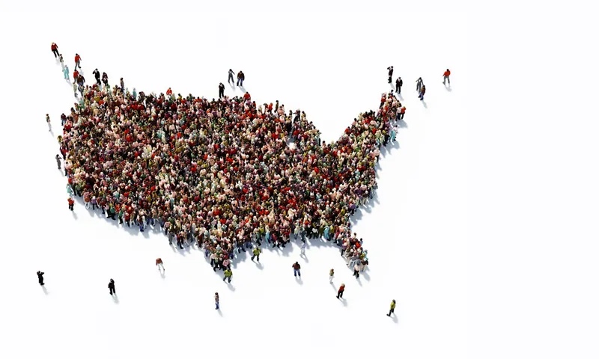
2020 US Census

Slide 2
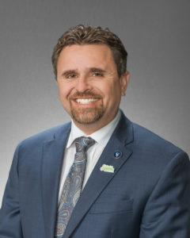
Councilman Dahir representing Sparks on Nevadas Complete Count Committee

Slide 3
What is the City of Sparks doing for Census 2020?

Slide 4
Multiple Media outlets

Slide 5
You can complete the questionnaire by mail, phone or online.

